Slide 1
Chapter 8

Slide 2
Objectives

Slide 3
Objectives (cont.)

Slide 4
View state concepts

Slide 5
View state concepts (cont.)

Slide 6
Two cases when you may want to disable view state

Slide 7
How to disable view state

Slide 8
How to enable view state for selected controls

Slide 9
How to determine the size of view state for a page

Slide 10
Common indexer of the StateBag class

Slide 11
A statement that adds or updates a view state item

Slide 12
A statement that retrieves the value of a view state item

Slide 13
Common indexer of the HttpSessionState class

Slide 14
A statement that adds or updates a session state item

Slide 15
The page events that can be used to get and save session state data

Slide 16
A Load event handler that gets the session state object named cart

Slide 17
A Click event handler that updates the cart object

Slide 18
A PreRender event handler that updates a value in the cart object

Slide 19
Four modes for storing session state data

Slide 20
Two options for tracking session IDs

Slide 21
Attributes of the session state element in the Web.config file

Slide 22
A sessionState element in the Web.config file that uses in-process mode

Slide 23
Application concepts

Slide 24
Cache concepts

Slide 25
Application state concepts

Slide 26
Common indexer of the HttpApplicationState and Cache classes

Slide 27
The Insert method of the Cache class

Slide 28
Common methods of the HttpApplicationState class

Slide 29
Two statements that add items to application state and cache

Slide 30
Two statements that retrieve an item from a non-page class

Slide 31
A statement that adds an item to cache with an absolute expiration time

Slide 32
Four common application events

Slide 33
A Global.asax file that creates an object in application state

Slide 34
A Global.asax file (cont.)

Slide 35
Examples of cookies

Slide 36
Two ways to create a cookie

Slide 37
Code that creates a session cookie

Slide 38
The HttpCookieCollection class

Slide 39
A method that creates a new cookie and adds it to the HttpResponse object

Slide 40
A method that retrieves the value of a cookie from the HttpRequest object

Slide 41
A method that deletes a persistent cookie

Slide 42
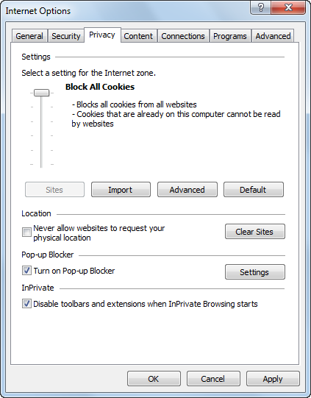
An IE dialog box with disabled cookies

Slide 43
How to enable or disable cookies for Internet Explorer

Slide 44
How to enable or disable cookies for Google Chrome

Slide 45
How to enable or disable cookies for Mozilla Firefox

Slide 46
Two URLs with query strings

Slide 47
A hyperlink with a URL that includes a query string

Slide 48
Statements that retrieve the values of the query string attributes

Slide 49
Code that uses a URL with a query string in a Redirect method

Slide 50
An SEO-friendly URL

Slide 51
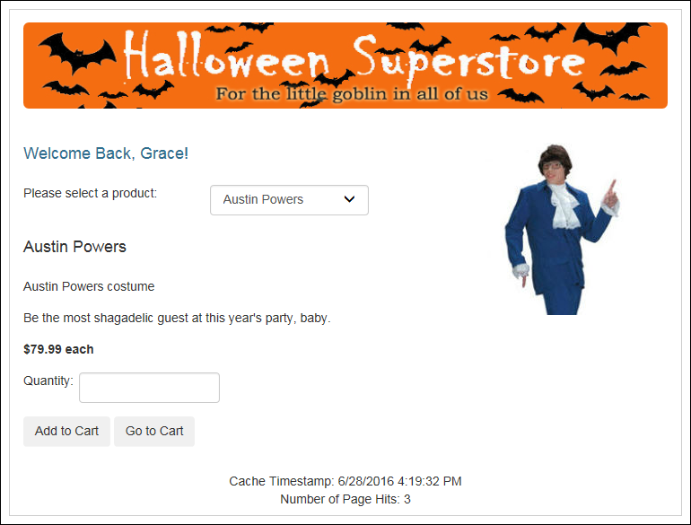
An Order page that uses a cookie and application state

Slide 52
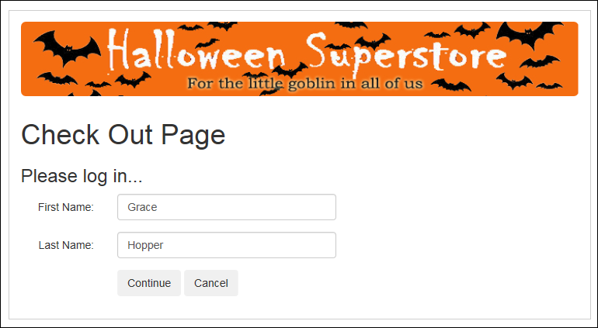
The CheckOut page

Slide 53
The aspx code for the welcome message and the footer on the Order page

Slide 54
The critical C# code for the Order page

Slide 55
The critical C# code for the Order page (cont.)

Slide 56
The critical C# code for the Check Out page

Slide 57
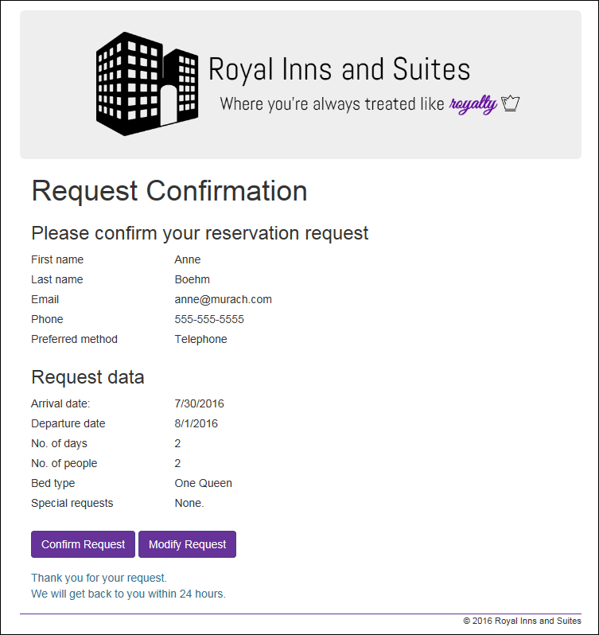
Extra 8-1 Use session state to store reservation data

Slide 58
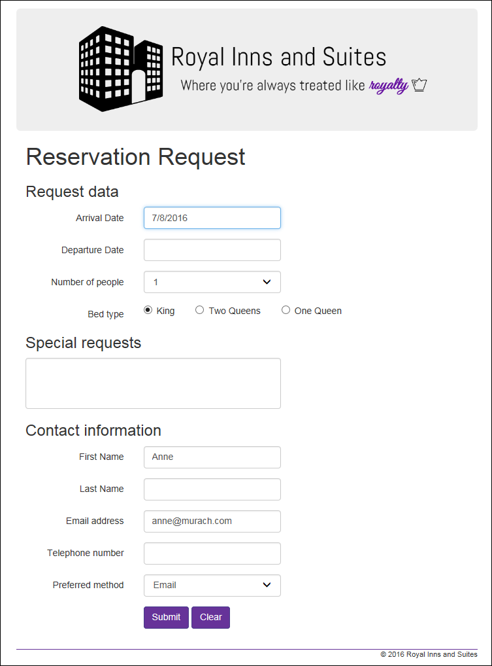
Extra 8-2 Use cookies to store user information

